Slide 1
Level 4/5 Group 18
Blake Hewitt, Elliot Dewhurst & Guy Zawada

Slide 2
What’s Our Idea?
Genre: Physics-Based, 2D, Sumo style, 1 on 1 arena game
Platform: Desktop PC for now…
Objective: Push your opponent off the arena

Slide 3
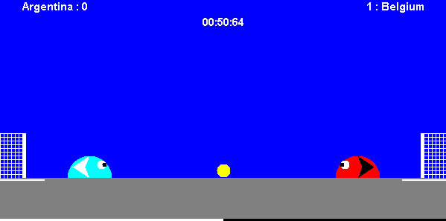
Previous Game Idea
Slime Soccer

Slide 4
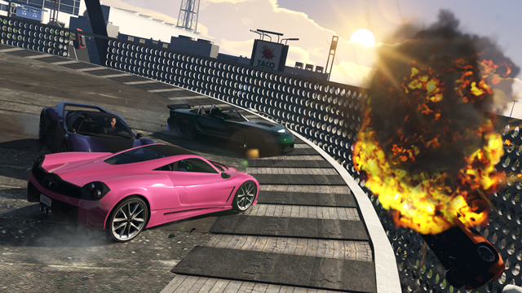
Inspirations for the idea
Sumo Cars – GTA V Multiplayer Minigame

Slide 5
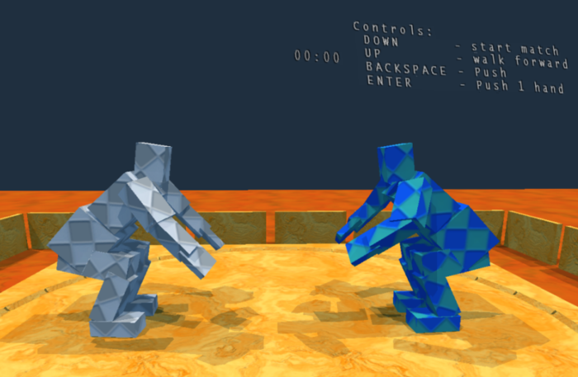
Inspirations for the idea
Sumotori
http://www.gravitysensation.com/sumotori/

Slide 6
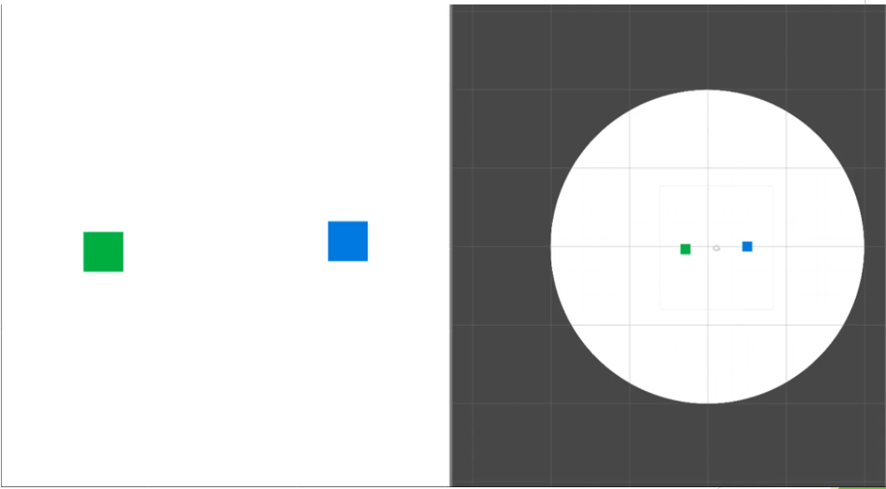
Early Prototype

Slide 7
Gameplay Demo

Slide 8

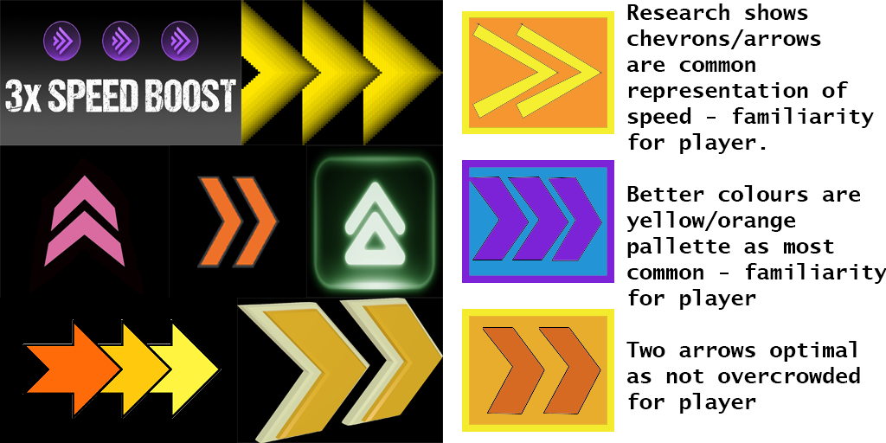
Mechanics
Physics-based pushing
Boost Mechanic
Avoidance of opponent and obstacles
Awareness of round timer

Slide 9


Design
Japanese-inspired theme
Quick-fire Rounds, multiple rounds per match
Strategic, risk and reward based power-up placement

Slide 10
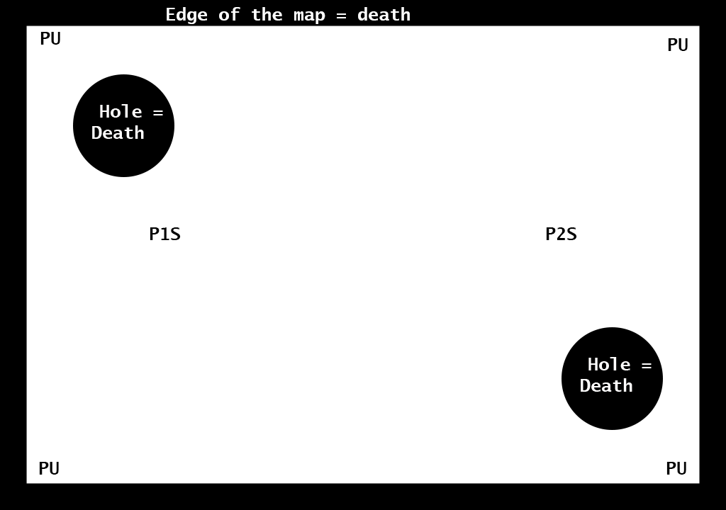
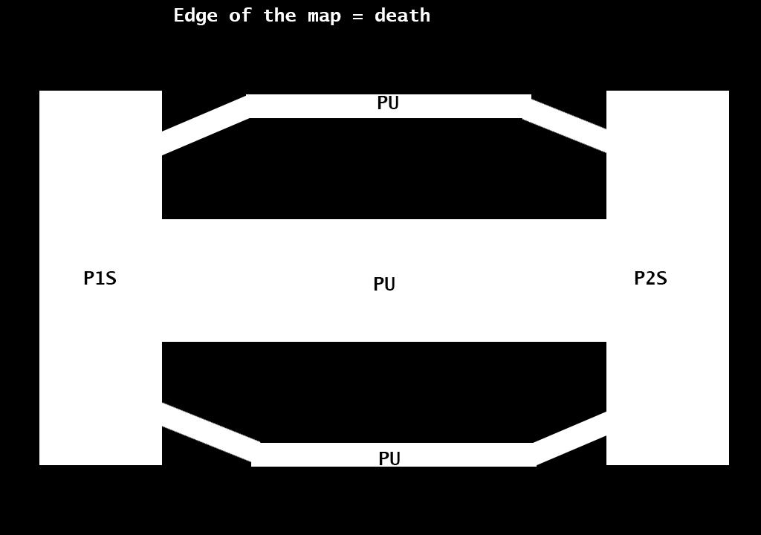
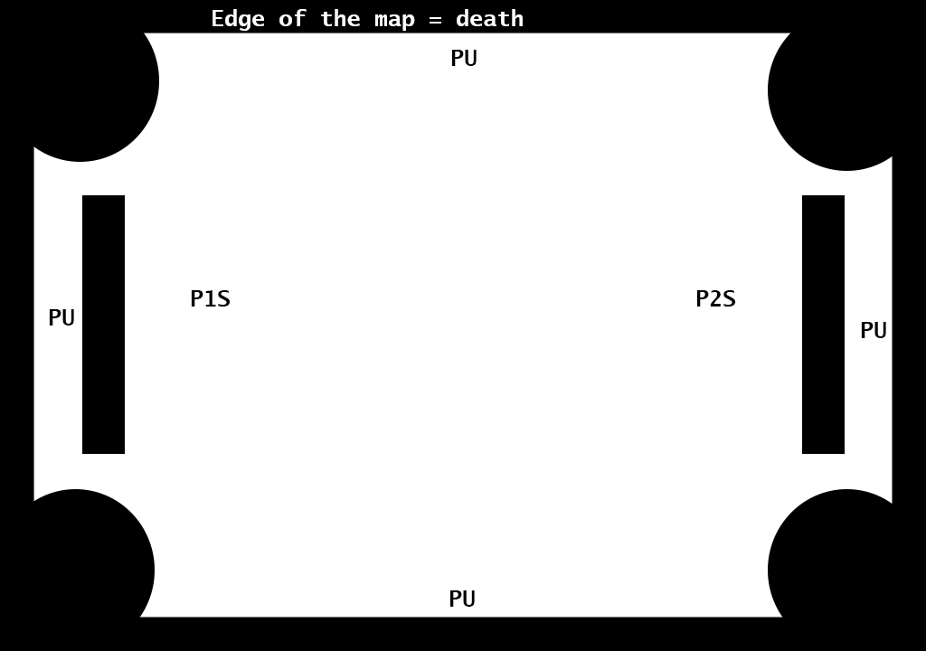
Level Designs

Slide 11







Level Design Details
Power Ups – Increase Mass, Increase Pushing Force, Increase Speed
Obstacles in the level
Random level for each round

Slide 12





UI/Screen Mock Up

Slide 13
Future/Stretch Goals
Based on playtesting feedback, in order of importance…
More Levels to choose from
Improve player character movement, make it less slippery
Improve Camera Zooming

Slide 14
Questions?

